Slide 1
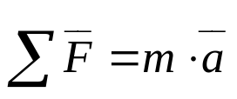
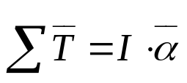
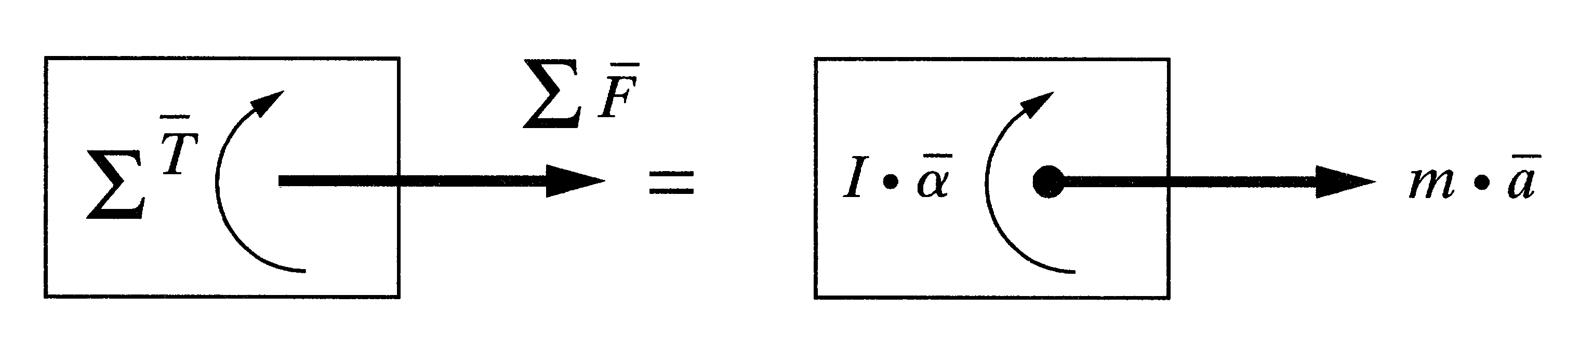
Chapter 4
Dynamic Analysis and Forces
4.1 INTRODUCTION
In this chapters…….
• The dynamics, related with accelerations, loads, masses and inertias.
Fig. 4.1 Force-mass-acceleration and torque-inertia-angular
acceleration relationships for a rigid body.
In Actuators…….
• The actuator can be accelerate a robot’s links for exerting enough forces
and torques at a desired acceleration and velocity.
• By the dynamic relationships that govern the motions of the robot,
considering the external loads, the designer can calculate the necessary
forces and torques.

Slide 2

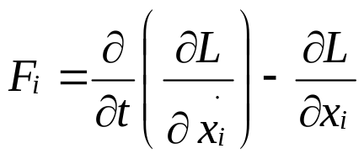
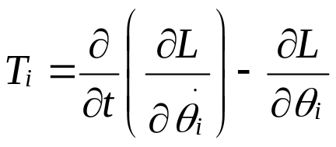
Chapter 4
Dynamic Analysis and Forces
4.2 LAGRANGIAN MECHANICS: A SHORT OVERVIEW
• Lagrangian mechanics is based on the differentiation energy terms
only, with respect to the system’s variables and time.
• Definition: L = Lagrangian, K = Kinetic Energy of the system, P = Potential
Energy, F = the summation of all external forces for a linear
motion, T = the summation of all torques in a rotational motion,
x = System variables

Slide 3
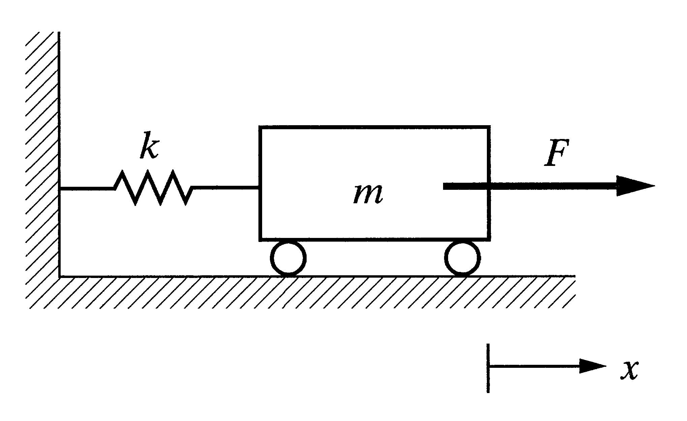
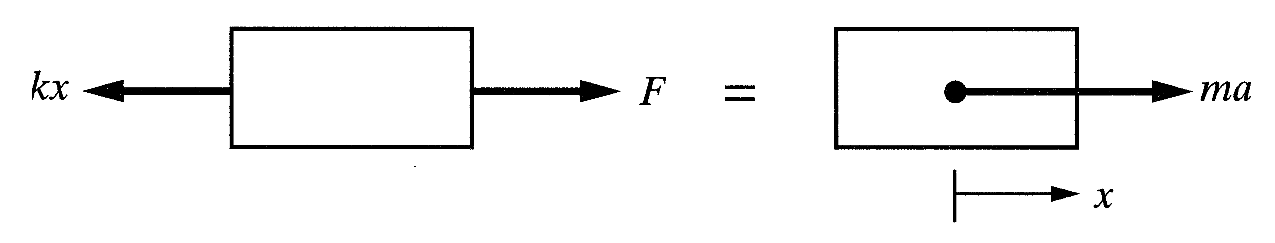
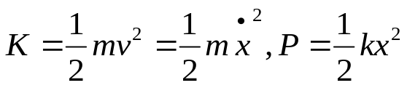
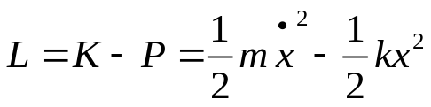
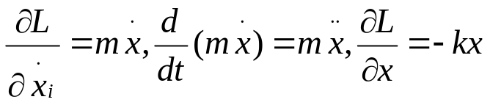


Chapter 4
Dynamic Analysis and Forces
Example 4.1
Derive the force-acceleration relationship for the one-degree of freedom system.
Fig. 4.2 Schematic of a simple cart-spring system.
Fig. 4.3 Free-body diagram for the sprint-cart system.
Solution
• Lagrangian mechanics
• Newtonian mechanics
• The complexity of the terms increases as the number of degrees of freedom
and variables.

Slide 4
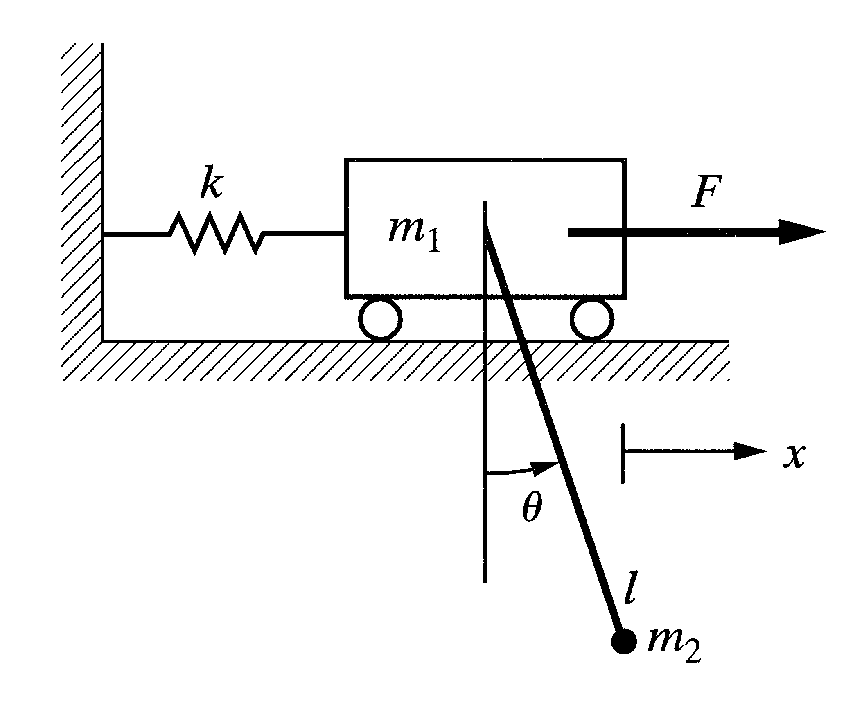
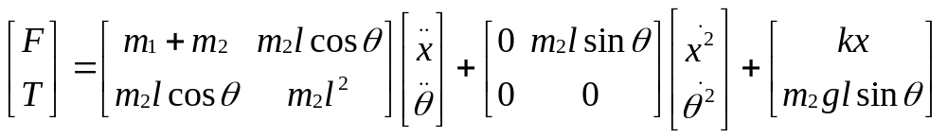
Chapter 4
Dynamic Analysis and Forces
Example 4.2
Derive the equations of motion for the two-degree of freedom system.
In this system…….
• It requires two coordinates, x and θ.
• It requires two equations of motion:
1. The linear motion of the system.
2. The rotation of the pendulum.
Fig. 4.4 Schematic of a cart-pendulum system.
Solution

Slide 5
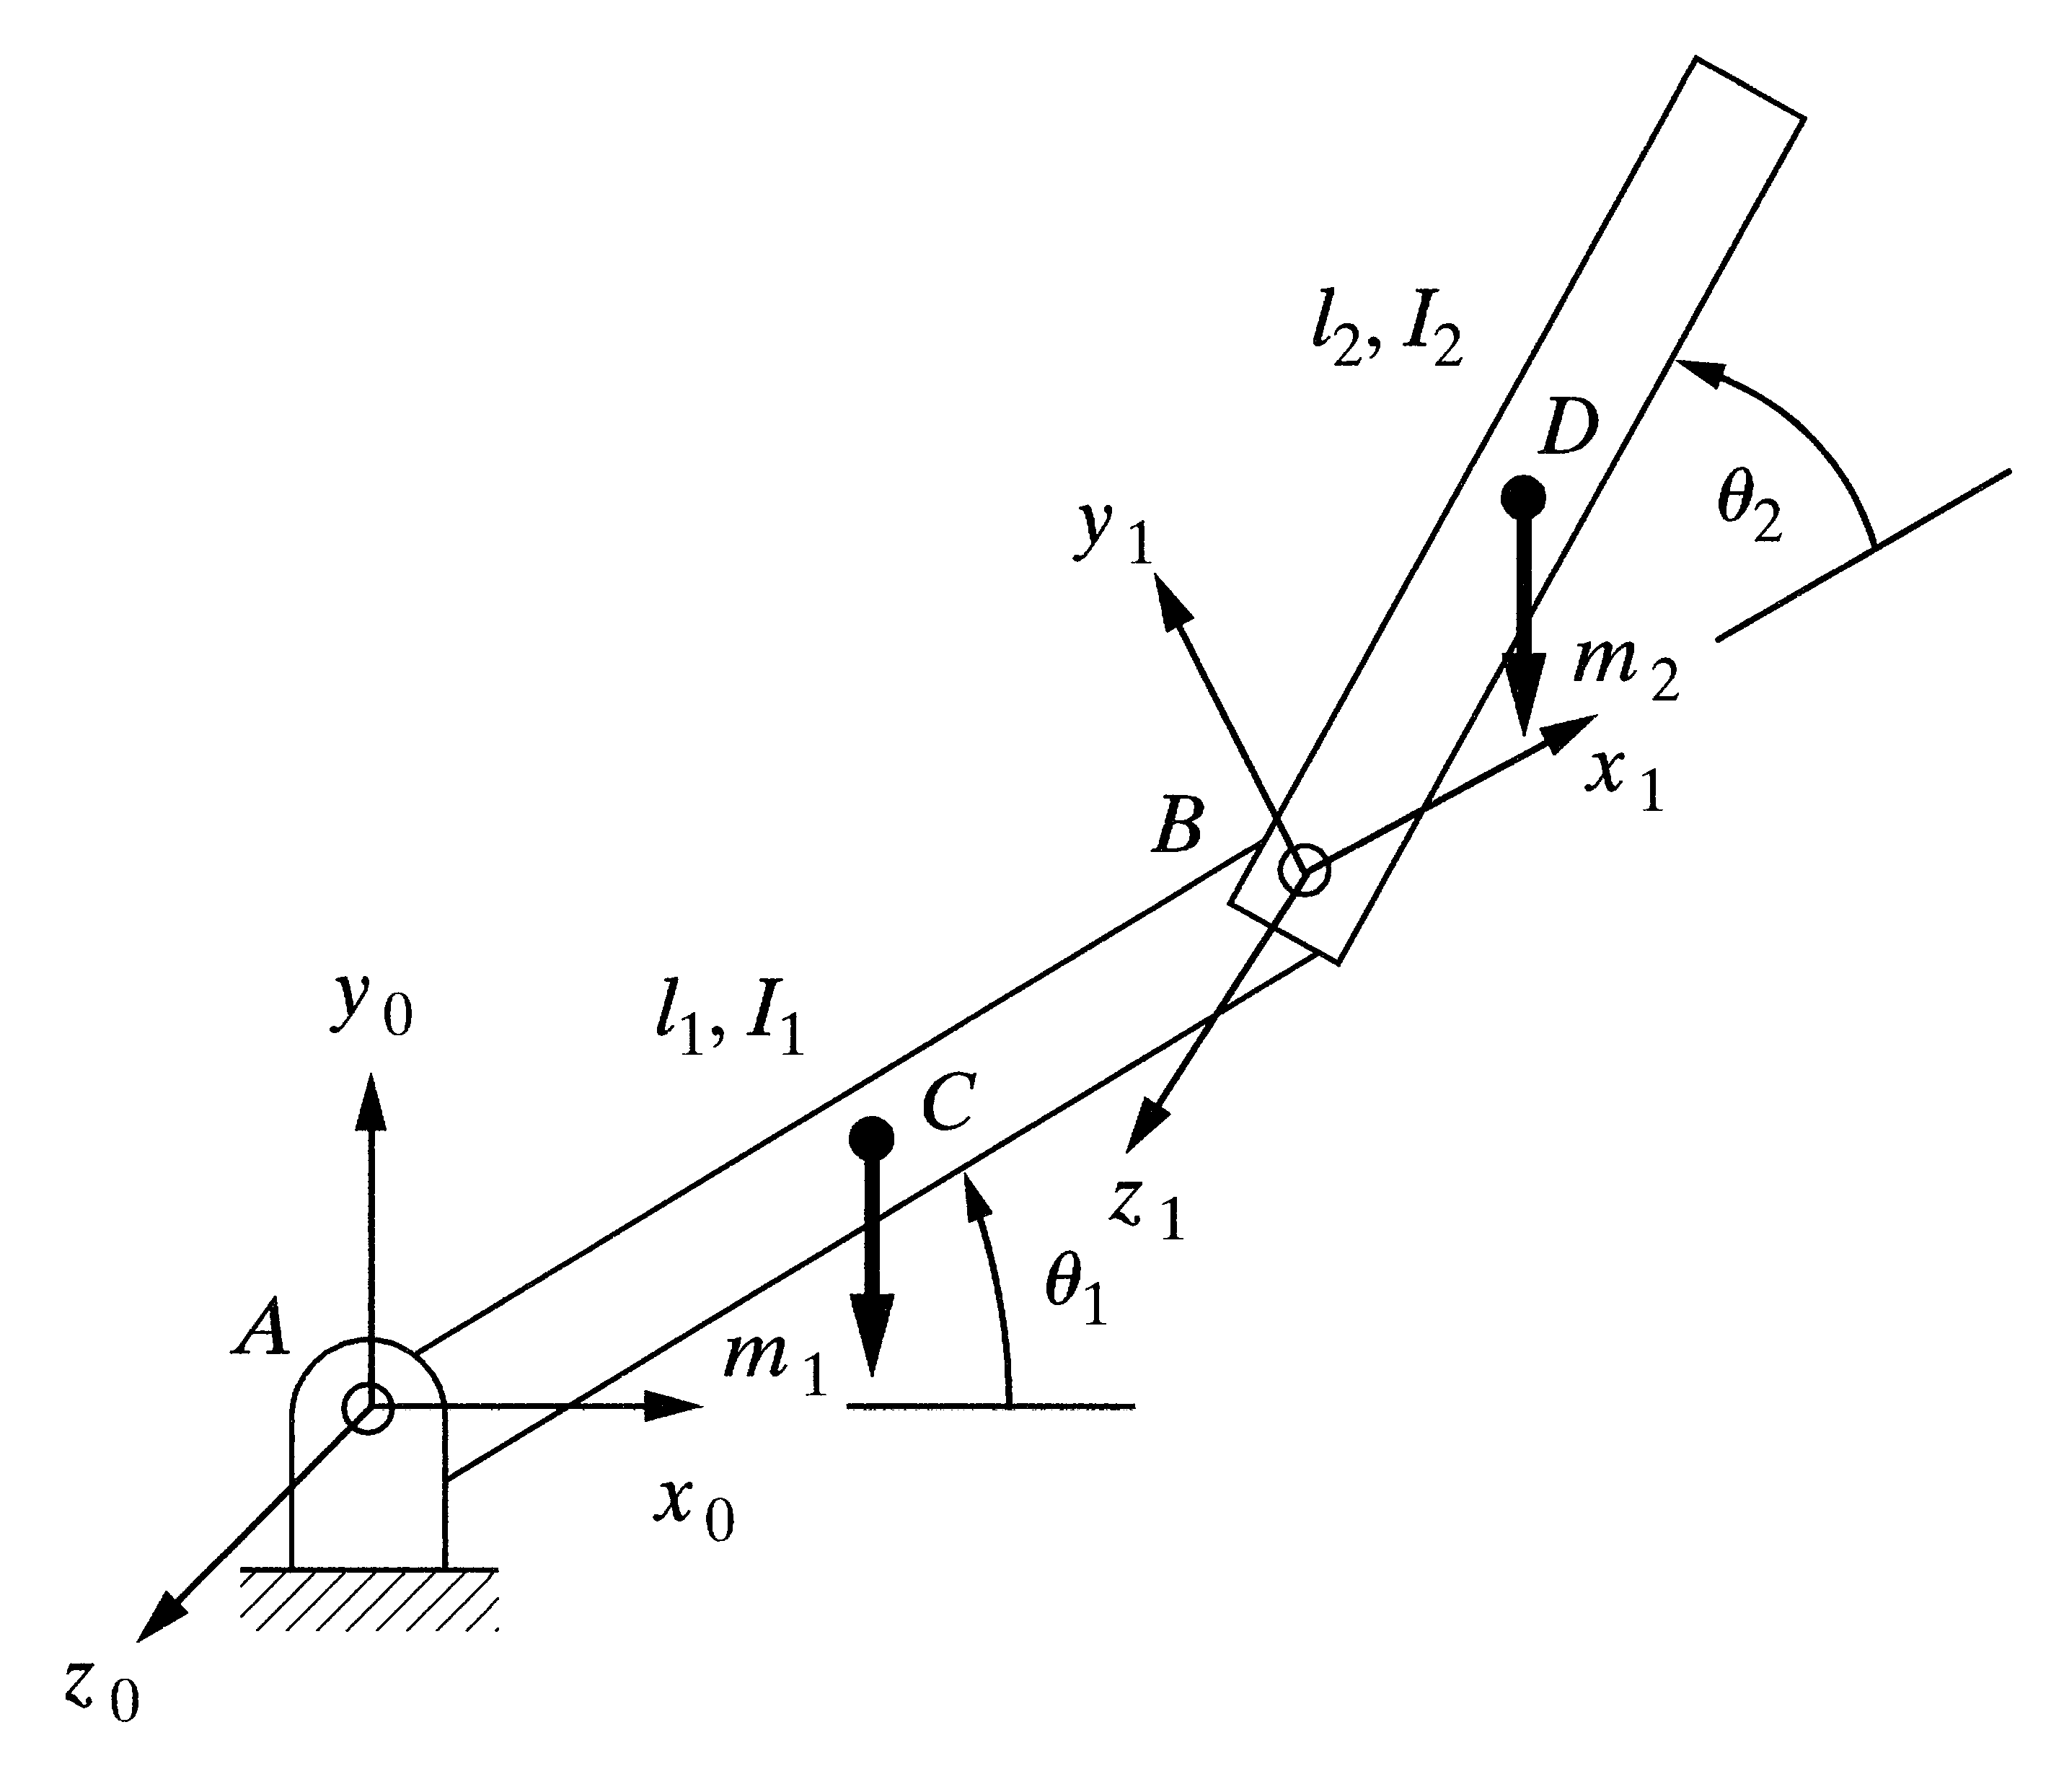
Chapter 4
Dynamic Analysis and Forces
Example 4.4
Using the Lagrangian method, derive the equations of motion for the two-degree of freedom robot arm.
Solution
Follow the same steps as before…….
• Calculates the velocity of the center of
mass of link 2 by differentiating its position:
• The kinetic energy of the total system is the
sum of the kinetic energies of links 1 and 2.
• The potential energy of the system is the
sum of the potential energies of the two
links:
Fig. 4.6 A two-degree-of-freedom robot arm.

Slide 6
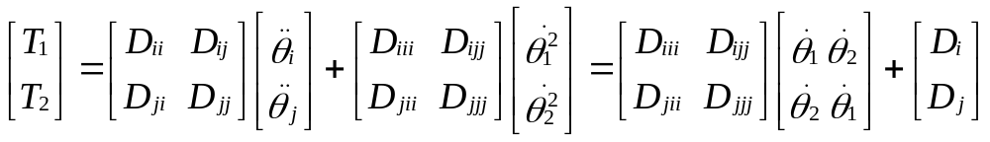
Chapter 4
Dynamic Analysis and Forces
4.3 EFFECTIVE MOMENTS OF INERTIA
• To Simplify the equation of motion, Equations can be rewritten in
symbolic form.

Slide 7
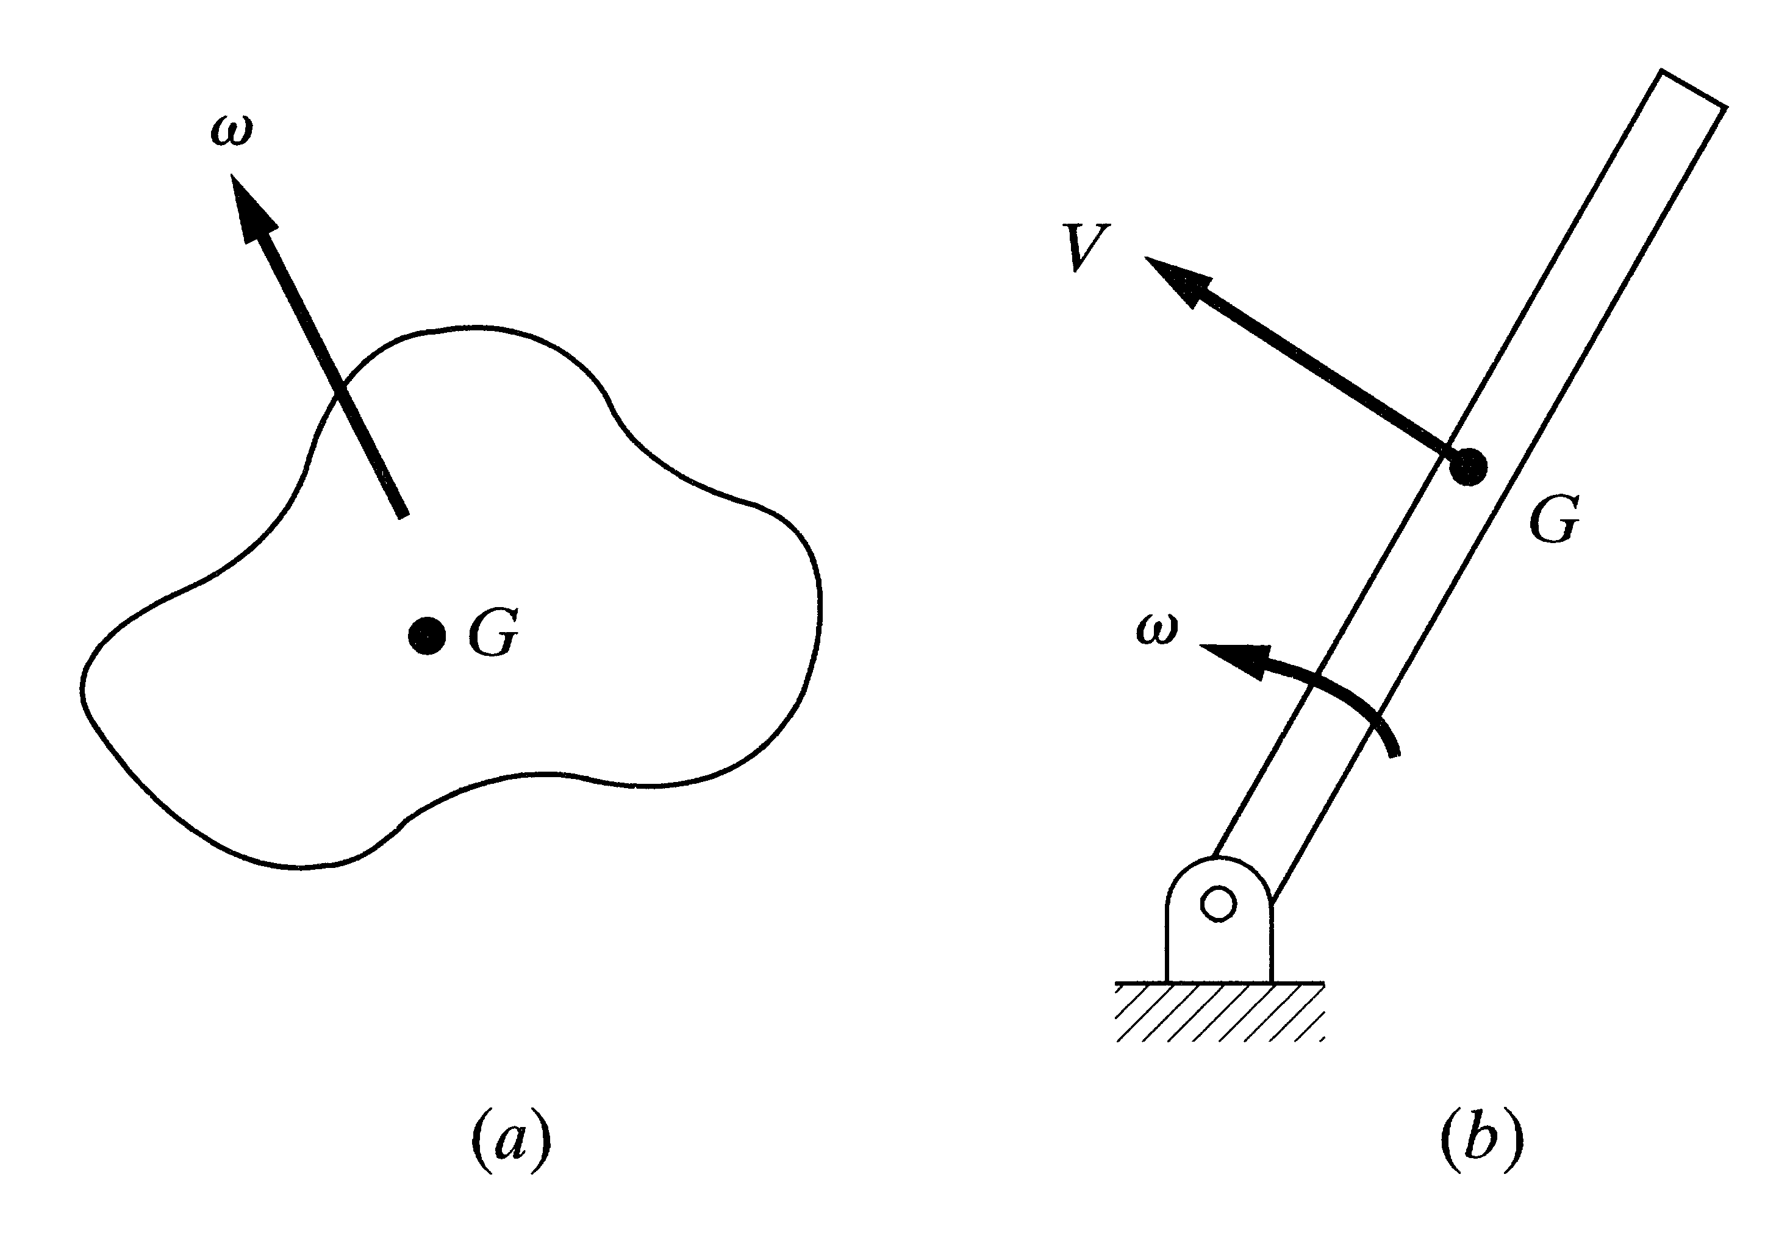
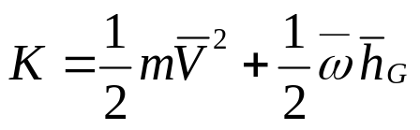
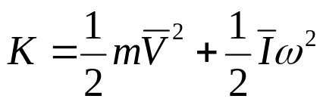
Chapter 4
Dynamic Analysis and Forces
4.4 DYNAMIC EQUATIONS FOR MULTIPLE-DEGREE-OF-FREEDOM ROBOTS
4.4.1 Kinetic Energy
• Equations for a multiple-degree-of-freedom robot are very long and
complicated, but can be found by calculating the kinetic and potential
energies of the links and the joints, by defining the Lagrangian and by
differentiating the Lagrangian equation with respect to the joint variables.
• The kinetic energy of a rigid body
with motion in three dimension :
• The kinetic energy of a rigid body
in planar motion
Fig. 4.7 A rigid body in three-dimensional motion and
in plane motion.

Slide 8
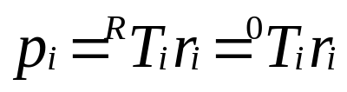
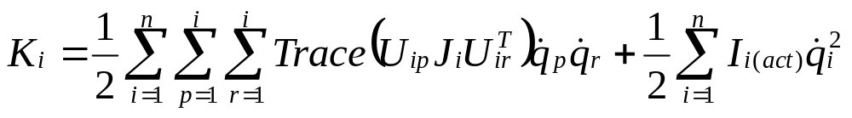
Chapter 4
Dynamic Analysis and Forces
4.4 DYNAMIC EQUATIONS FOR MULTIPLE-DEGREE-OF-FREEDOM ROBOTS
4.4.1 Kinetic Energy
• The velocity of a point along a robot’s link can be defined by differentiating
the position equation of the point.
• The velocity of a point along a robot’s link can be defined by differentiating
the position equation of the point.

Slide 9
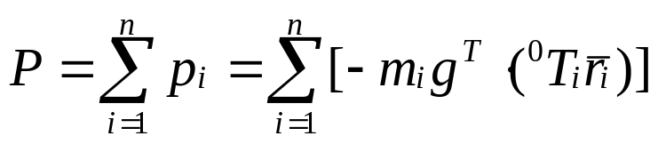
Chapter 4
Dynamic Analysis and Forces
4.4 DYNAMIC EQUATIONS FOR MULTIPLE-DEGREE-OF-FREEDOM ROBOTS
4.4.2 Potential Energy
• The potential energy of the system is the sum of the potential energies of each link.
• The potential energy must be a scalar quantity and the values in the gravity
matrix are dependent on the orientation of the reference frame.

Slide 10
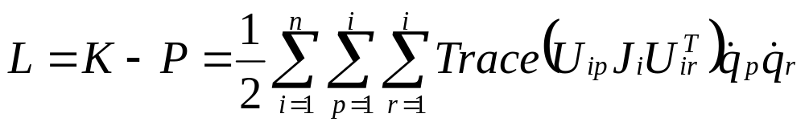
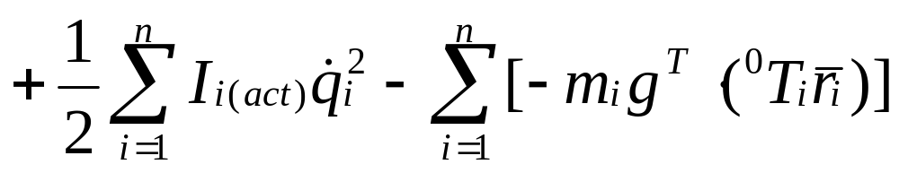
Chapter 4
Dynamic Analysis and Forces
4.4 DYNAMIC EQUATIONS FOR MULTIPLE-DEGREE-OF-FREEDOM ROBOTS
4.4.3 The Lagrangian

Slide 11
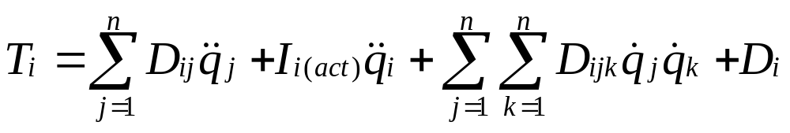
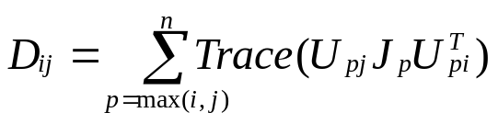
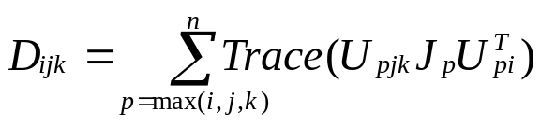
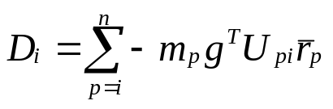
Chapter 4
Dynamic Analysis and Forces
4.4 DYNAMIC EQUATIONS FOR MULTIPLE-DEGREE-OF-FREEDOM ROBOTS
4.4.4 Robot’s Equations of Motion
• The Lagrangian is differentiated to form the dynamic equations of motion.
• The final equations of motion for a general multi-axis robot is below.
where,

Slide 12



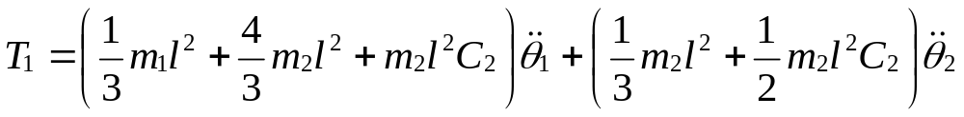
Chapter 4
Dynamic Analysis and Forces
Example 4.7
Using the aforementioned equations, derive the equations of motion for the two-degree of freedom robot arm. The two links are assumed to be of equal length.
Follow the same steps as before…….
• Write the A matrices for the two links;
• Develop the , and for the robot.
Fig. 4.8 The two-degree-of-freedom robot arm of Example 4.4
Solution
• The final equations of motion without the actuator inertia terms are the same as below.

Slide 13
Chapter 4
Dynamic Analysis and Forces
4.5 STATIC FORCE ANALYSIS OF ROBOTS
• Robot Control means Position Control and Force Control.
• Position Control: The robot follows a prescribed path without any reactive force.
• Force Control: The robot encounters with unknown surfaces and manages to
handle the task by adjusting the uniform depth while getting the reactive force.
Ex) Tapping a Hole - move the joints and rotate them at particular rates to
create the desired forces and moments at the hand frame.
Ex) Peg Insertion – avoid the jamming while guiding the peg into the hole and
inserting it to the desired depth.

Slide 14
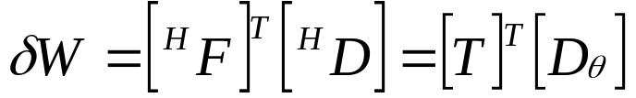
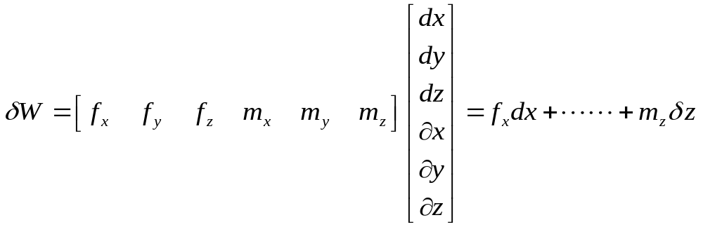

Chapter 4
Dynamic Analysis and Forces
4.5 STATIC FORCE ANALYSIS OF ROBOTS
• To Relate the joint forces and torques to forces and moments generated at the
hand frame of the robot.
• f is the force and m is the moment
along the axes of the hand frame.
• The total virtual work at the joints
must be the same as the total work
at the hand frame.
• Referring to Appendix A

Slide 15




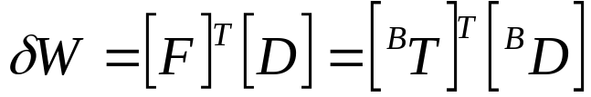
Chapter 4
Dynamic Analysis and Forces
4.6 TRANSFORMATION OF FORCES AND MOMENTS BETWEEN COORDINATE FRAMES
• An equivalent force and moment with respect to the other coordinate frame
by the principle of virtual work.
• The total virtual work performed on the object in either frame must be the same.

Slide 16






Chapter 4
Dynamic Analysis and Forces
4.6 TRANSFORMATION OF FORCES AND MOMENTS BETWEEN COORDINATE FRAMES
• Displacements relative to the two frames are related to each other by the
following relationship.
• The forces and moments with respect to frame B is can be calculated directly
from the following equations:

